Slide 1
Rock Paper Scissors

Slide 2
Lobe AI
Use Lobe AI to make your own Machine Learning models and use them for demonstrative or educational purposes or just for fun!
Since the Lobe application allows us to export our model and use it outside the application, we can use it on mobile platforms such as Raspberry Pi

Slide 3
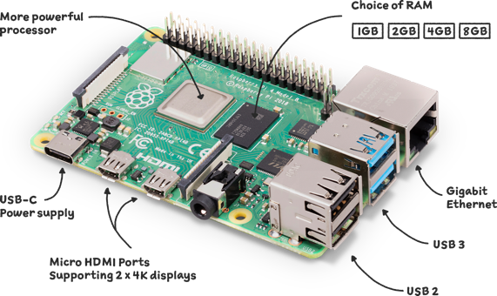
Raspberry Pi
A Raspberry Pi is a microcomputer that runs a version of Linux called Raspbian
There are lots of different use cases for a Raspberry Pi, from controlling LEDs or a digital clock through the GPIO pins to replacing a traditional computer and even running trained Machine Learning models
There are many different versions of Raspberry Pi, but for this demo, we will be using a Raspberry Pi 4

Slide 4
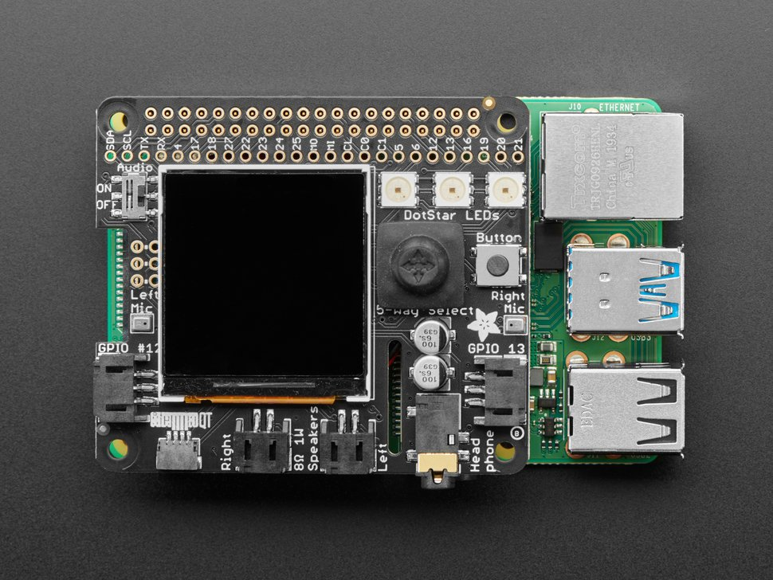
Brain Craft Hat
An easy way to visualize ML results is to use a Brain Craft Hat
The Brain Craft Hat is a printed circuit board that plugs into the raspberry pi’s GPIO pins and provides an easy input/output interface for the pi
By using the Brain Craft Hat’s onboard display, we can see the results from the ML model without connecting a monitor.

Slide 5
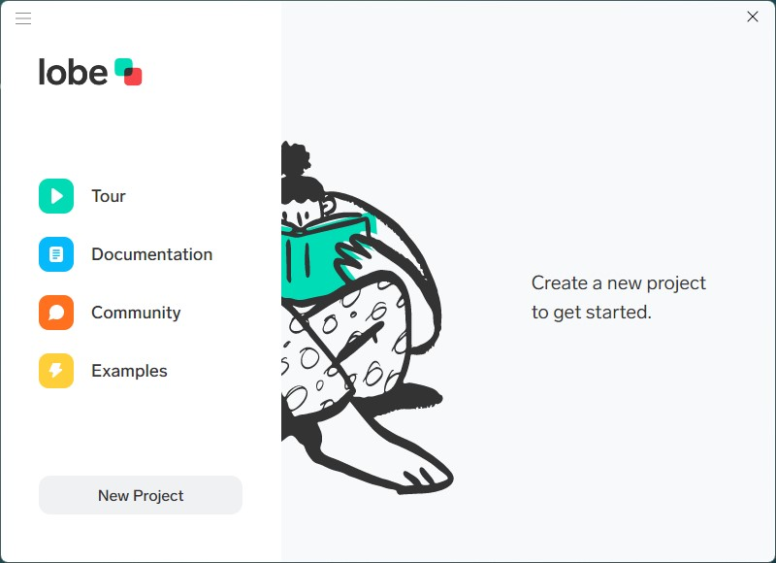
Rock Paper Scissors
Open the Lobe AI application and start a new project

Slide 6
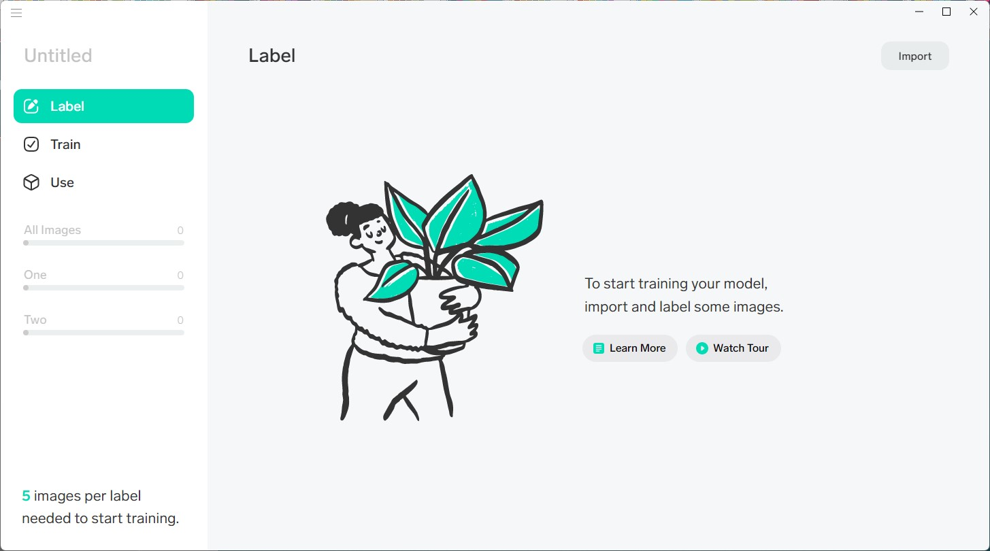
Rock Paper Scissors
Click “Import” in the top right hand corner

Slide 7
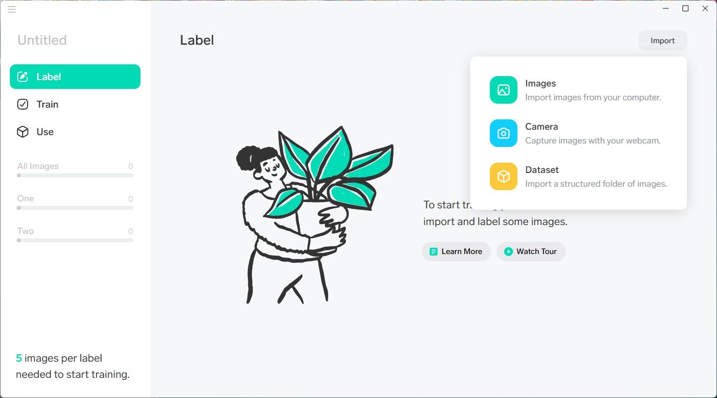
Rock Paper Scissors
Click “Camera” to use your web camera as the data source

Slide 8
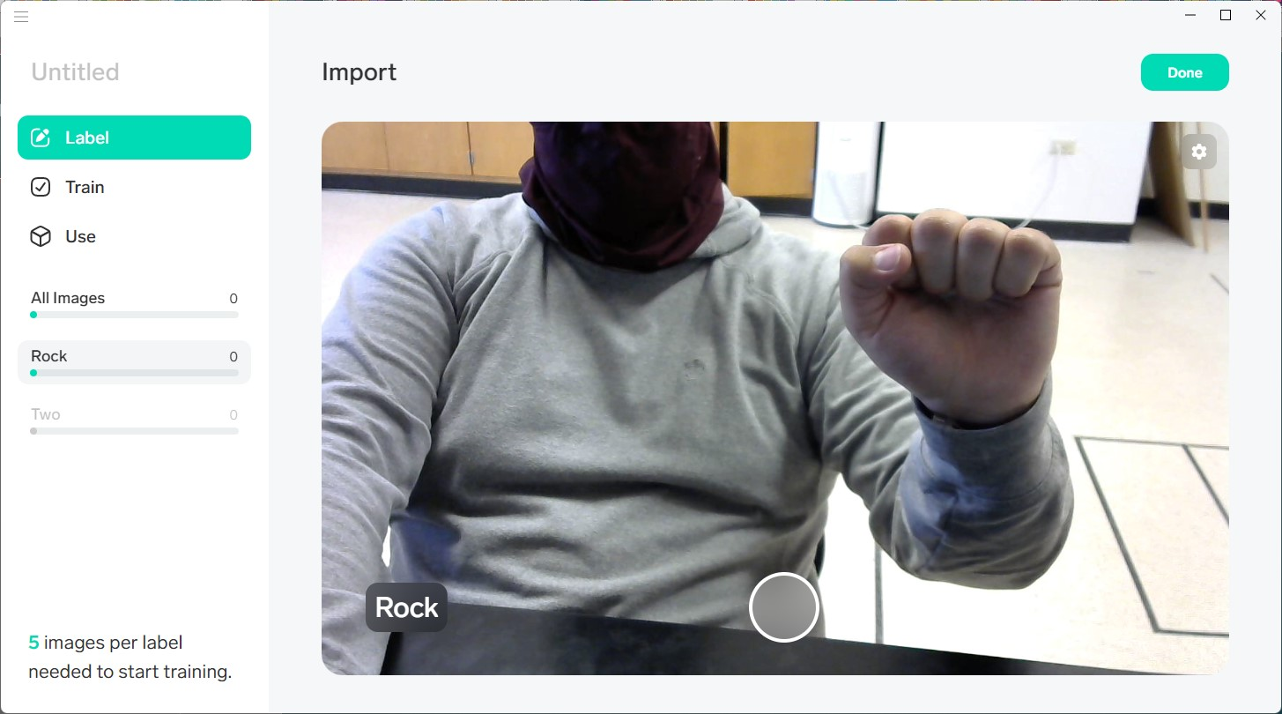
Rock Paper Scissors
Change the label to “Rock” and take 10 photos

Slide 9
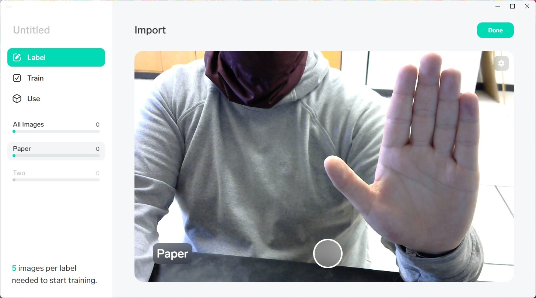
Rock Paper Scissors
Change the label to “Paper” and take 10 photos

Slide 10
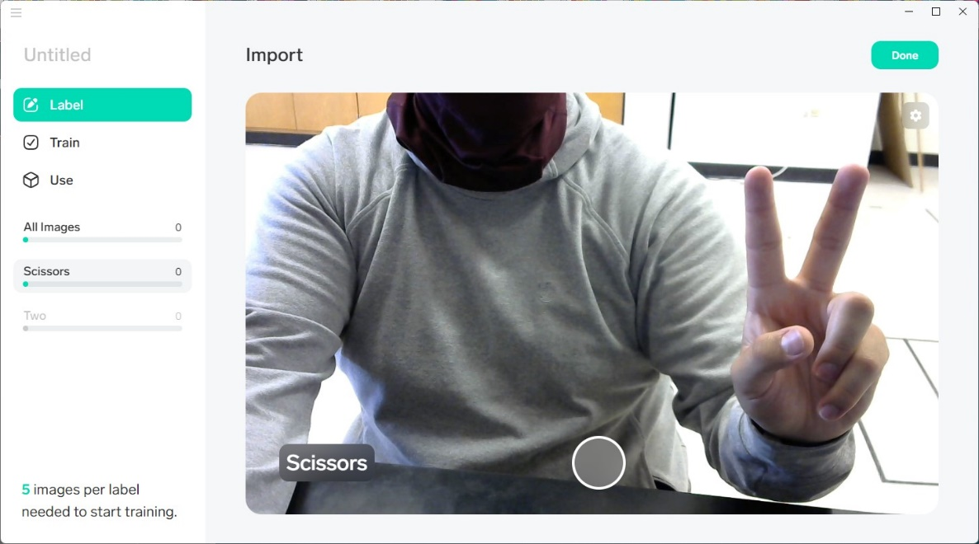
Rock Paper Scissors
Change the label to “Scissors” and take 10 photos
When finished, click “Done”

Slide 11
Rock Paper Scissors
Click on the “Train” tab on the left-hand side
If the model is having some issues labeling some of the images, click on the incorrect label and select the correct label

Slide 12
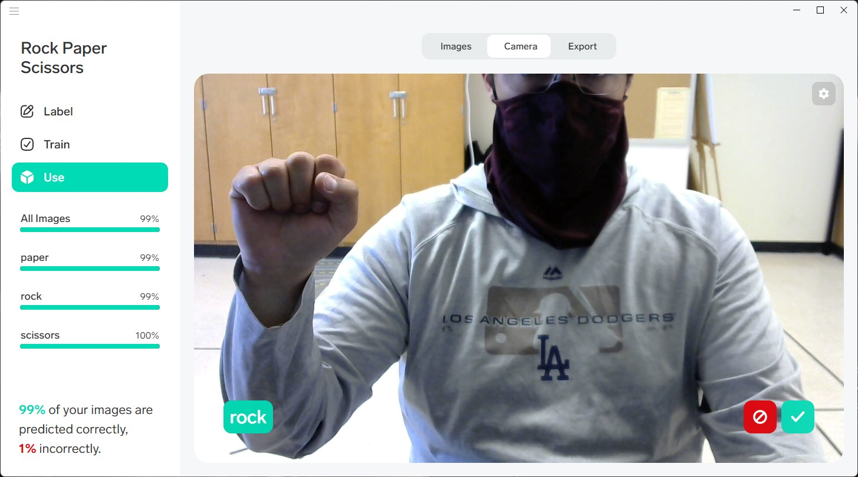
Rock Paper Scissors
Once training is complete, click on the “Use” tab and test your model using the camera. Record the results on the provided sheet

Slide 13
Rock Paper Scissors
How well did your model / AI perform?
How do you think it could be improved?
Which labels, rock, paper, or scissors, did your model guess wrong more often?

Slide 14
Rock Paper Scissors
Loading a trained model using Lobe onto the Raspberry Pis
For this model, we used almost 3000 images of different hands doing Rock, Paper, and Scissors
This took a very long time to train
The model was trained in Lobe AI and exported to a TensorFlow Lite file, and loaded onto the Raspberry Pi
TensorFlow is a free and open-source software for machine learning

Slide 15
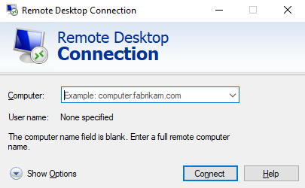
Connect to the Raspberry Pi
Plug in and power on the Raspberry Pi with the Brain Craft Hat; make sure to also plug in the ethernet cable
Launch the Remote Desktop Connection application from your computer

Slide 16
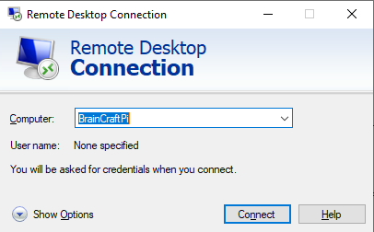
Connect to the Raspberry Pi
Type in the name of your Raspberry Pi into the text box where it says ‘Computer’

Slide 17
Connect to the Raspberry Pi
Click “Connect”
If the connection doesn’t work, try <computer_name>.local
For example, bcpi-001.local

Slide 18
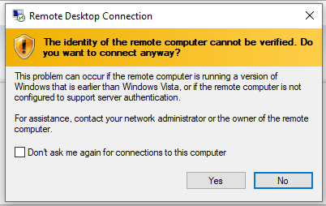
Connecting to the Raspberry Pi
If you get this pop up after clicking Connect, click the box next to “Don’t ask me again for connections to this computer and then click Yes

Slide 19
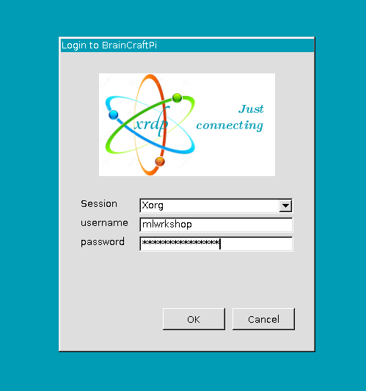
Connecting to the Raspberry Pi
Enter the login information to the pi
Username: rpi
Password: raspberry

Slide 20
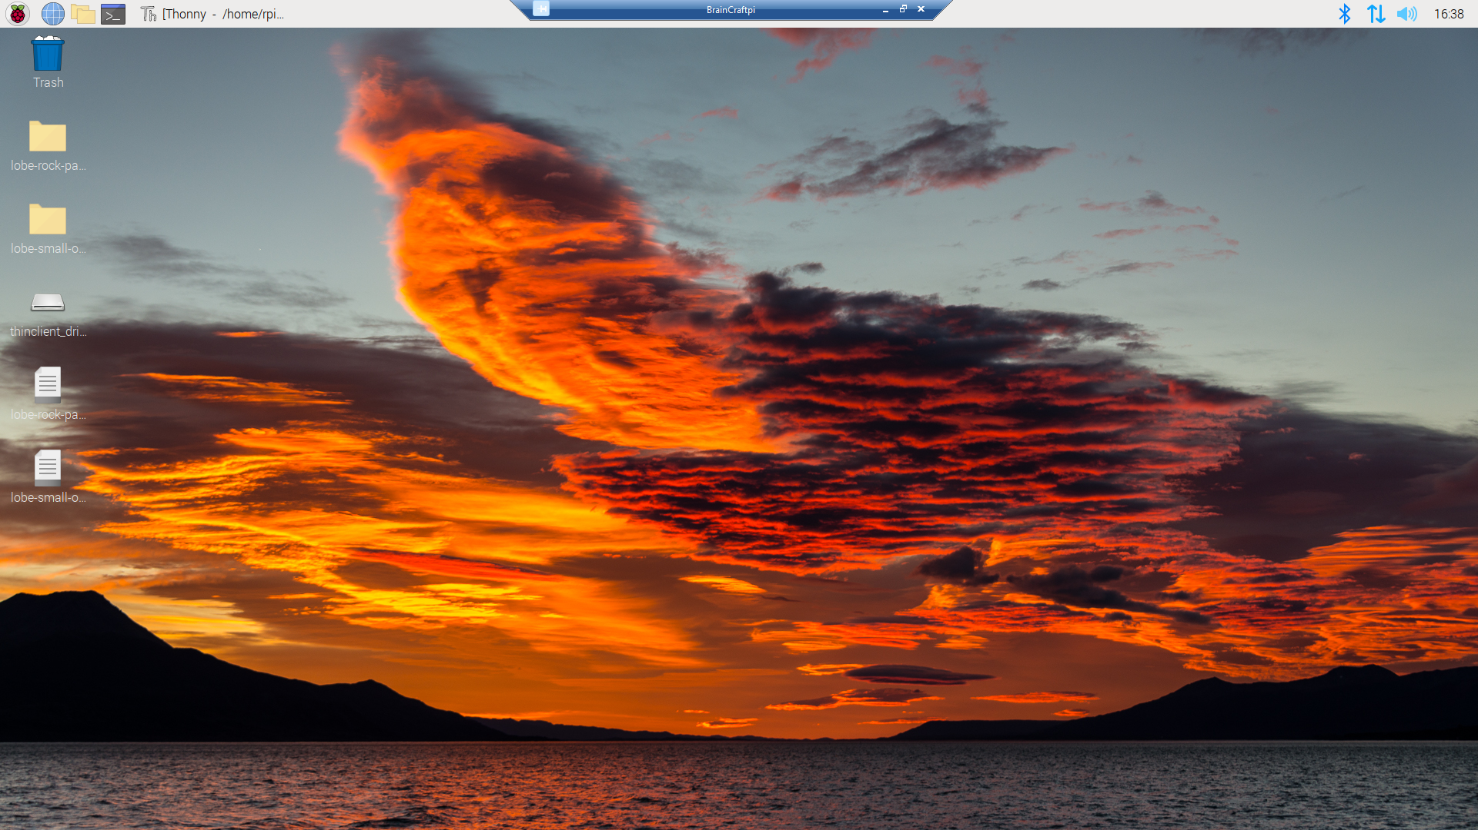
Launching the Program
Double click the python file named “lobe-rock-paper-scissors.py” on the left side of the desktop

Slide 21
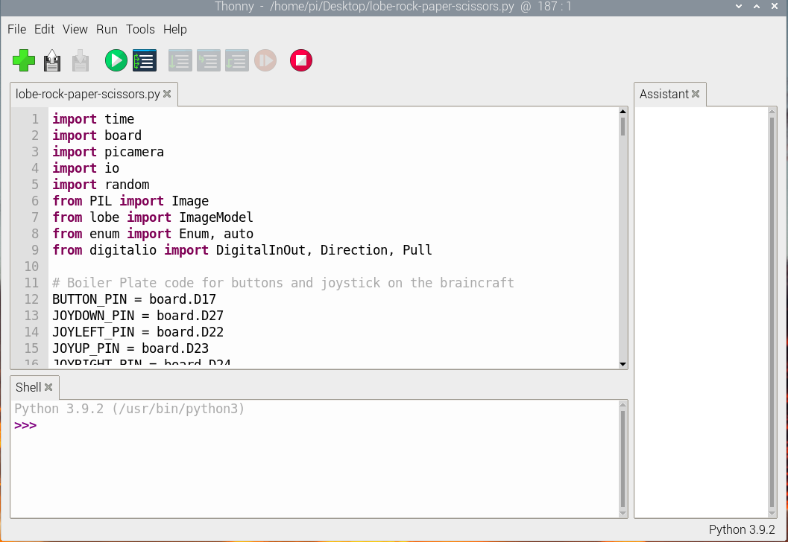
Launching the Program
Thoney IDE should launch with the python file
Click the Green Run button

Slide 22
Playing with the model
The program will play a game of rock, paper, scissors with you
It does this by:
Randomly selecting one of the three options Rock, Paper, or Scissors
Detecting your selected option through the camera
Referencing a dictionary as to which player won that round
Each round has a countdown timer of 3 seconds before your chosen option is recorded
Use the provided paper to record the same number of rounds as the number of tests you simulated in Lobe

Slide 23
Playing with the model
If you look down at the Raspberry Pi, you’ll notice the LCD screen is on and displaying the camera
To start a round, press the button labeled “Button” on the right side of the board

Slide 24
Discussion with your Neighbor
How accurate is the model on the Raspberry Pi?
How does the model on the Raspberry Pi perform compared to the model you trained?
What role did the data contribute to the performance?

